Slide 1

Intermolecular Forces of Attraction

Slide 2
CA Standards
Students know the atoms and molecules in liquids move in a random pattern relative to one another because the intermolecular forces are too weak to hold the atoms or molecules in a solid form.

Slide 3
Intermolecular Forces
Forces that attract molecules to other molecules. These include:
  Hydrogen bonding
  Dipole-dipole attraction
  London dispersion forces

Slide 4
Relative Magnitudes of Forces
The types of bonding forces vary in their strength as measured by average bond energy.
Strongest
Weakest
Covalent bonds (400 kcal)
Hydrogen bonding (12-16 kcal )
Dipole-dipole interactions (2-0.5 kcal)
London forces (less than 1 kcal)

Slide 5
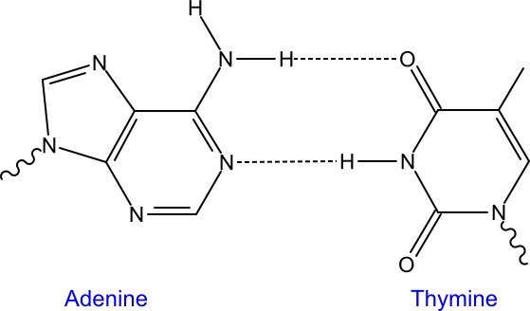
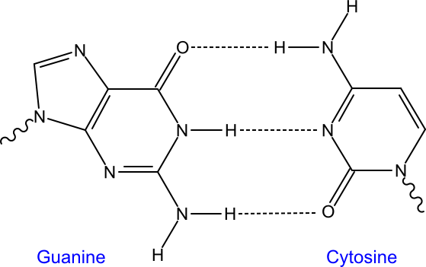
Hydrogen Bonding
Bonding between hydrogen and more electronegative neighboring atoms such as oxygen and nitrogen
Base pairing in DNA by hydrogen bonding

Slide 6
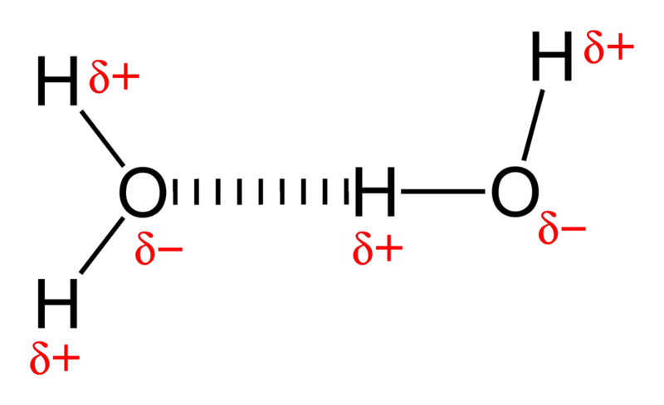
Hydrogen Bonding in Water

Slide 7
Polarity
A molecule, such as HF, that has a center of positive charge and a center of negative charge is said to be polar, or to have a dipole moment.
H
F
δ+
δ-

Slide 8
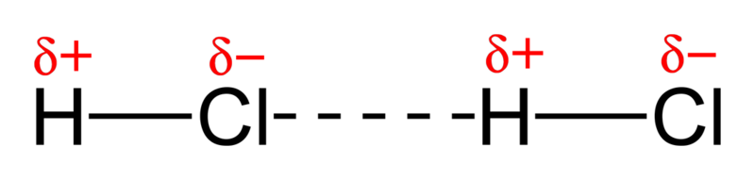
Dipole-Dipole Attraction
Attraction between oppositely charged regions of neighboring molecules.
Dipole-dipole attraction in hydrogen chloride, a gas that is used to make hydrochloric acid

Slide 9
London (Dispersion) Forces
The weakest of intermolecular forces, these forces are proportional to the mass of the molecule
These are the only forces of attraction between completely nonpolar molecules
  Large nonpolar molecules may have substantial dispersion forces, resulting in relatively high boiling points
  Small nonpolar molecules have weak dispersion forces and exist almost exclusively as gases

Slide 10
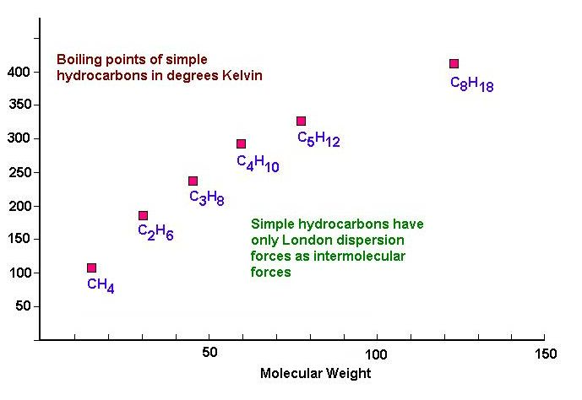
London Forces in Hydrocarbons

